Slide 1

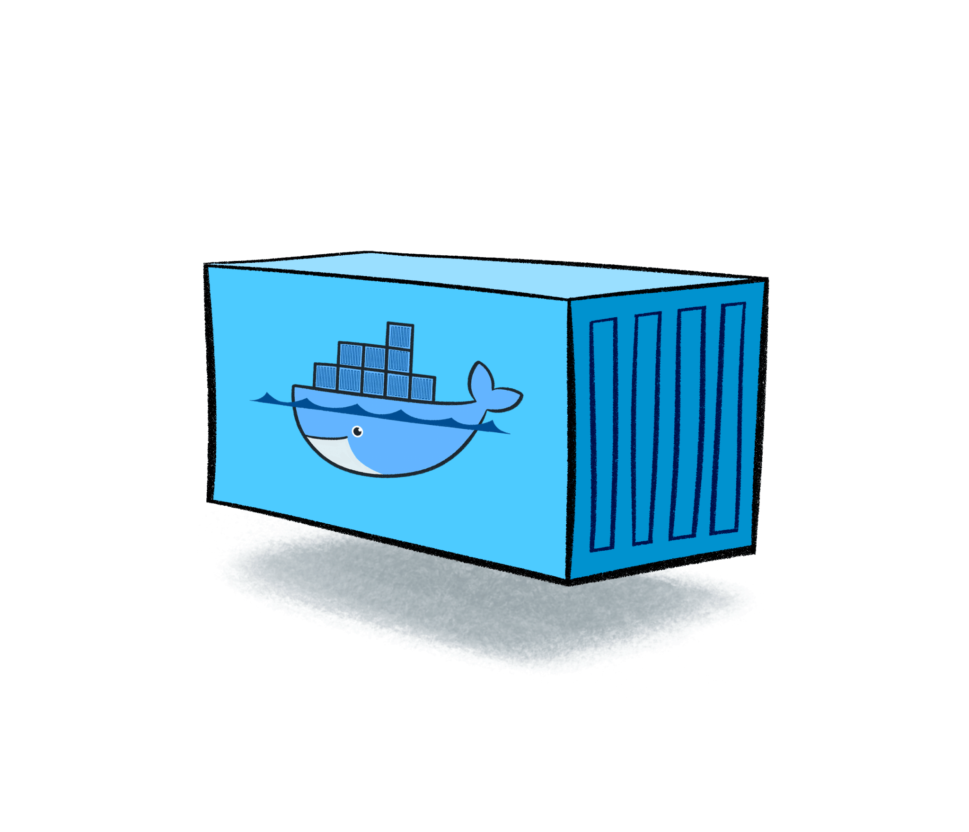
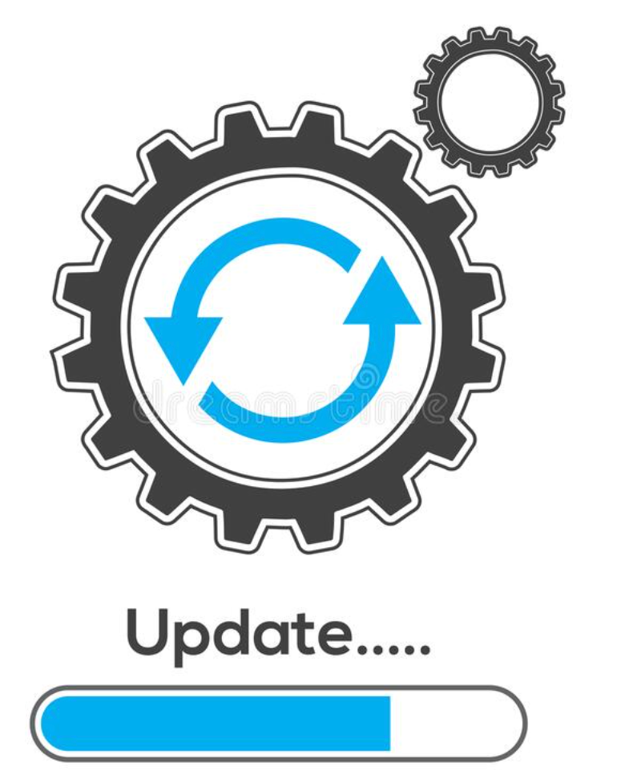

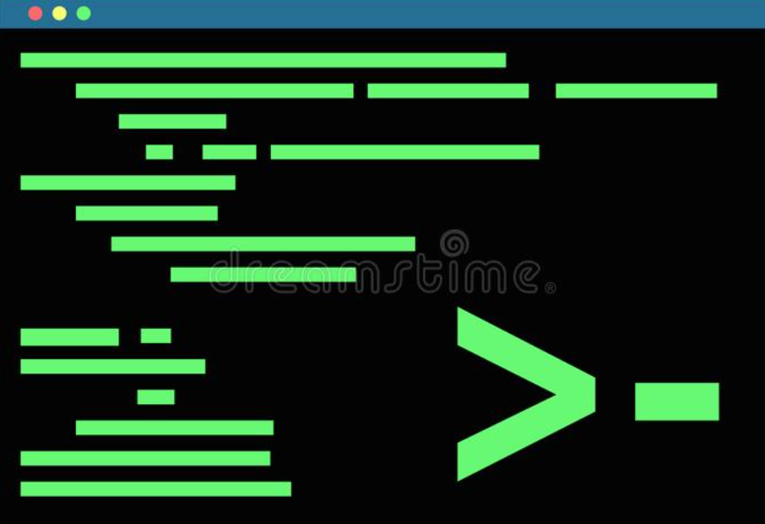
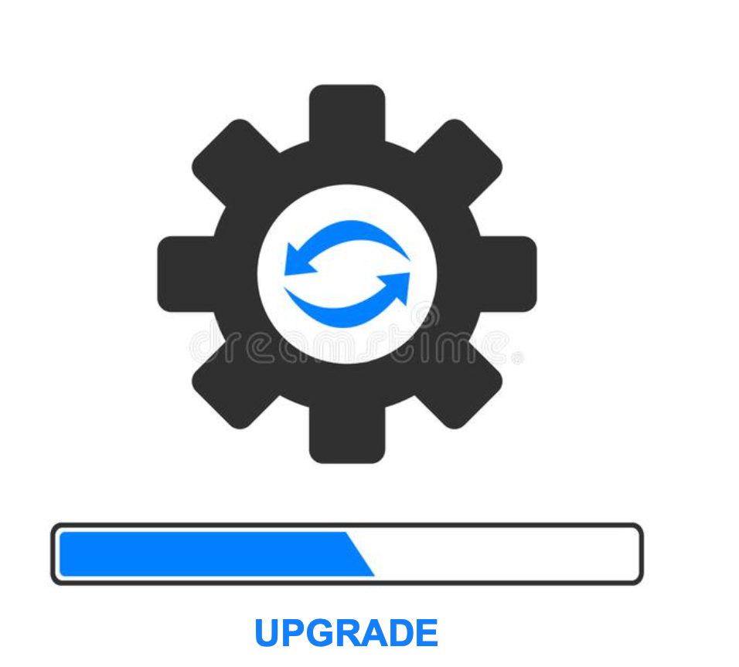

CP4D – Administration Day 2 Operation – Upgrade from 4.6.3 to 4.6.4
https://www.ibm.com/docs/en/cloud-paks/cp-data/4.6.x?topic=upgrading
Note: READ THE DOCUMENTATION
This is a guided example of one possible scenario. This is NOT a replacement for the documentation.
Cluster Detail: OCP 4.10.54 ODF Storage
Cloud Pak Version: CP4D V4.6.3. [ wkc, datastage, db2 wearhouse ]
Express Install
Step.4) Upgrade CPD Platform Services
Note: Read this page carefully.
There are two tasks you must complete. Update OLM Objects & Upgrade Components
Update OLM Objects ← Follow these steps
[outline of the steps]
cpd-cli login to cluster
cpd-cli verify status of the custom resources
cpd-cli Update the OLM Objects
(This will recreate the operators in the ibm-common-services project)
Upgrade Components ← Follow these steps
[outline of the steps]
cpd-cli login to cluster
cpd-cli Update the custom resources
(The update command is specific to the type of storage on your cluster)
Note: Updating individual components is as simple as putting one component in the comma delimited list:
--components=<component> (wkc as an example)
cpd-cli Verify the status
BACK UP YOUR DATA!!
Install Plan : Set to Automatic
Step.1) Update cpd-cli & olm-utils image
Daffy Tool Command to install the latest version of CPD-CLI
/data/daffy/tools.sh --installCP4DCloudCLI
cpd-cli download
olm-utils update single client workstation
Step.2) Identify what components are installed
Note: Read this page carefully.
All OLM objects on the cluster MUST be at the same version
There are 2 options: Update individual components or update all at the same time.
NOTE: Not recommended to update all components if you have Analytics Engine (Spark), Data Privacy, or WKC (Update those individually)
Step.3) Create environment variables script
Note: Read this page carefully.
The documentation assumes you installed CP4D with the CPD-CLI command line utility. If you did NOT, you will need to create a new env variables script to set the variables. Example
If you DID install CP4D using the CPD-CLI, you will have a cpd_vars.sh script (modify the existing cpd_vars.sh file)
Two important variables: Update these to the correct values
VERSION=4.6.4
COMPONENTS=<Your Component List from Step 2>
Note: cpfs,scheduler,cpd_platform. ← These are required and
should be first.
Post-Upgrade Tasks
Review these pages for information that could potentially apply to your scenario. These tasks may or may not apply to your scenario.
Setting up Services after upgrade (Some CP4D services have post upgrade tasks)
Update the RSI Webhook (complete this step ONLY if you want to use the RSI feature to customize the specifications of the pods)
Troubleshooting upgrade Troubleshooting CPD Limitations and known issues for WKC

